Slide 1
Chapter 5
Advanced Data Modeling

Slide 2
Learning Objectives
In this chapter, you will learn:
  About the extended entity relationship (EER) model
  How entity clusters are used to represent multiple entities and relationships
  The characteristics of good primary keys and how to select them
  How to use flexible solutions for special data-modeling cases

Slide 3
Extended Entity Relationship Model (EERM)
Result of adding more semantic constructs to the original entity relationship (ER) model
EER diagram (EERD): Uses the EER model

Slide 4
Entity Supertypes and Subtypes
Entity supertype: Generic entity type related to one or more entity subtypes
  Contains common characteristics
Entity subtype: Contains unique characteristics of each entity subtype
Criteria to determine the usage
  There must be different, identifiable kinds of the entity in the user’s environment
  The different kinds of instances should each have one or more attributes that are unique to that kind of instance

Slide 5
Specialization Hierarchy
Depicts arrangement of higher-level entity supertypes and lower-level entity subtypes
Relationships are described in terms of “is-a” relationships
Subtype exists within the context of a supertype
Every subtype has one supertype to which it is directly related
Supertype can have many subtypes

Slide 6
Specialization Hierarchy
Provides the means to:
  Support attribute inheritance
  Define a special supertype attribute known as the subtype discriminator
  Define disjoint/overlapping constraints and complete/partial constraints

Slide 7
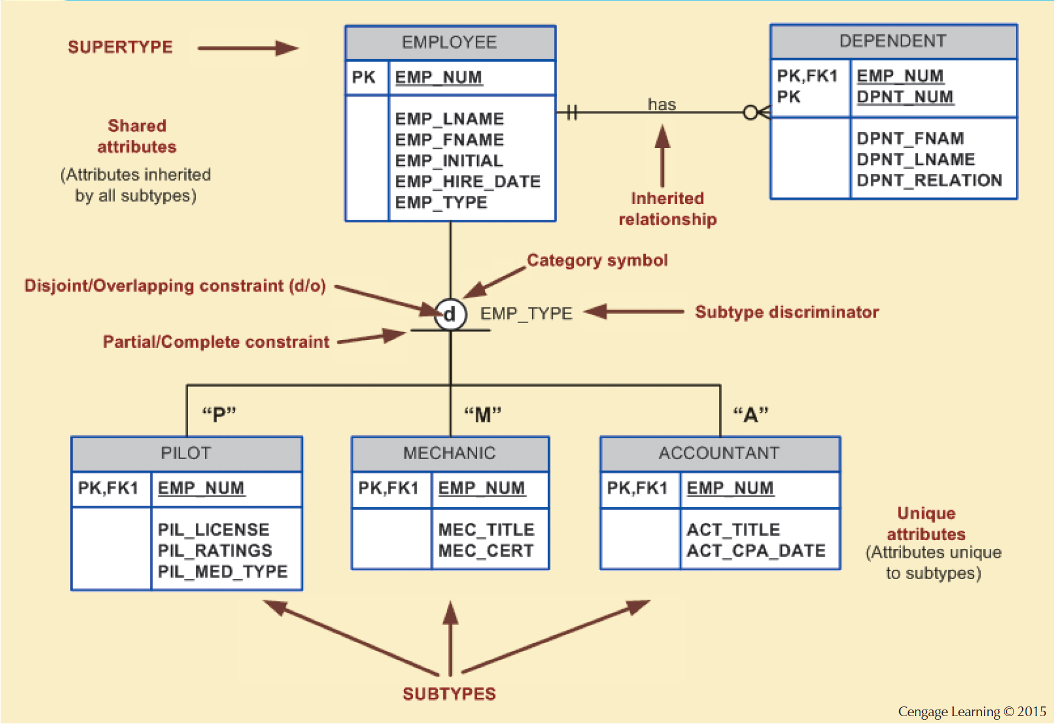
Figure 5.2 - Specialization Hierarchy

Slide 8
Inheritance
Enables an entity subtype to inherit attributes and relationships of the supertype
All entity subtypes inherit their primary key attribute from their supertype
At the implementation level, supertype and its subtype(s) maintain a 1:1 relationship
Entity subtypes inherit all relationships in which supertype entity participates
Lower-level subtypes inherit all attributes and relationships from its upper-level supertypes

Slide 9
Subtype Discriminator
Attribute in the supertype entity that determines to which entity subtype the supertype occurrence is related
Default comparison condition is the equality comparison

Slide 10
Disjoint and Overlapping Constraints
Disjoint subtypes: Contain a unique subset of the supertype entity set
  Known as nonoverlapping subtypes
  Implementation is based on the value of the subtype discriminator attribute in the supertype
Overlapping subtypes: Contain nonunique subsets of the supertype entity set
  Implementation requires the use of one discriminator attribute for each subtype

Slide 11
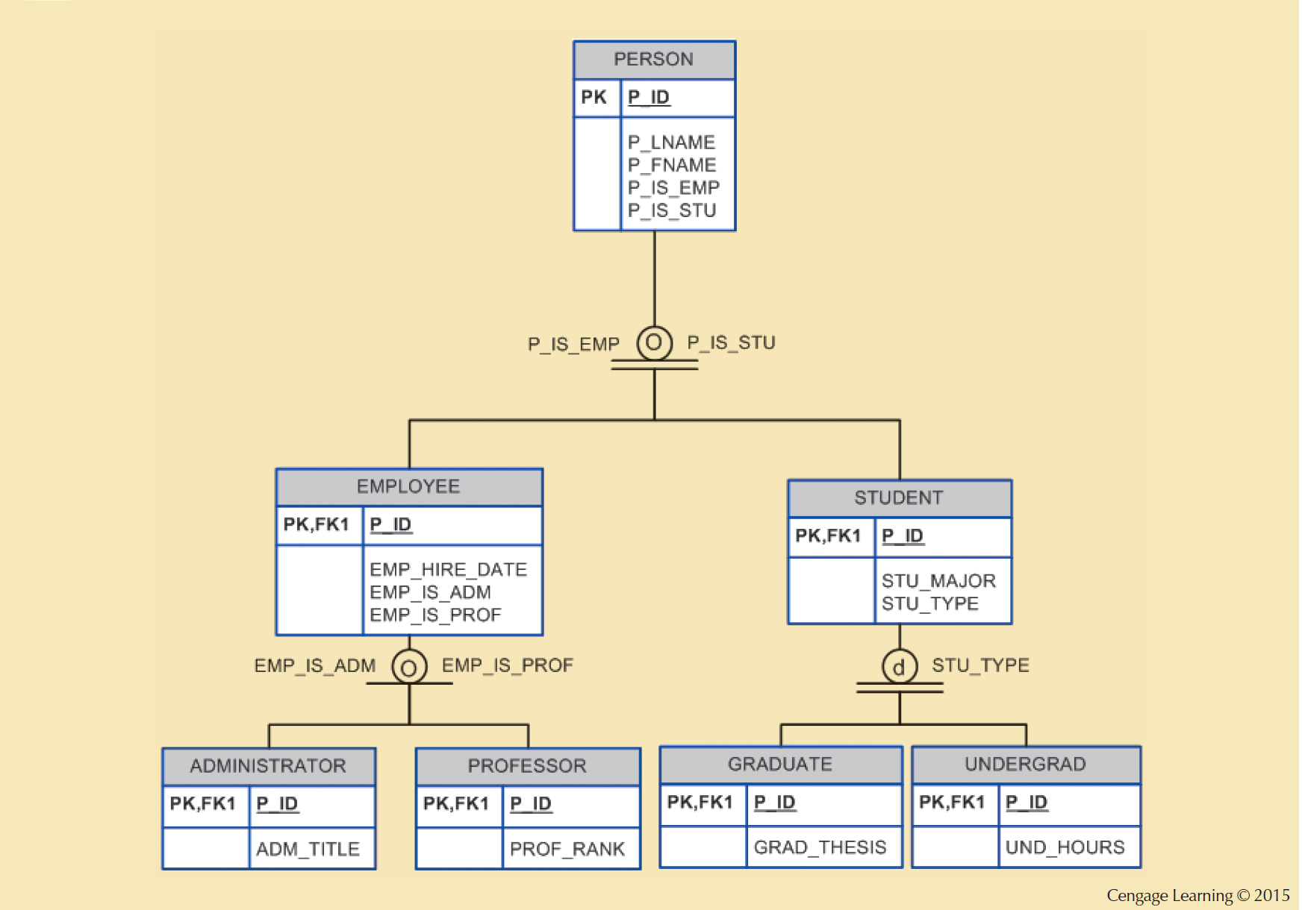
Figure 5.4 - Specialization Hierarchy with Overlapping Subtypes

Slide 12
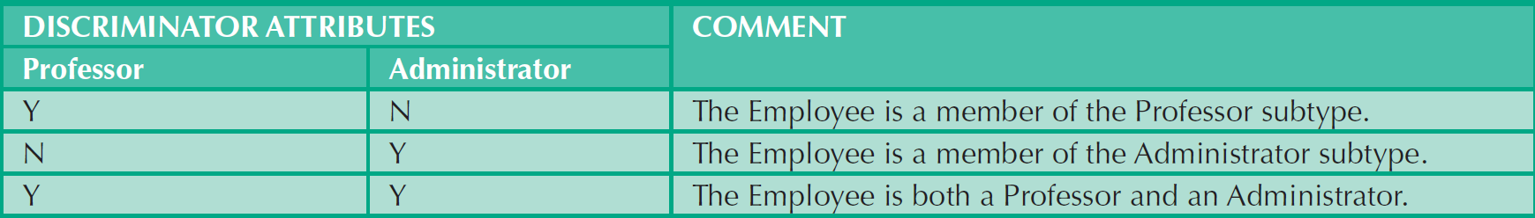
Table 5.1 - Discriminator Attributes with Overlapping Subtypes

Slide 13
Completeness Constraint
Specifies whether each supertype occurrence must also be a member of at least one subtype
Types
  Partial completeness: Not every supertype occurrence is a member of a subtype
  Total completeness: Every supertype occurrence must be a member of any

Slide 14
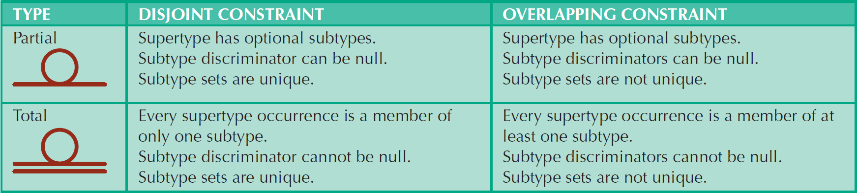
Table 5.2 - Specialization Hierarchy Constraint Scenarios

Slide 15
Specialization and Generalization
Specialization
Generalization
  Top-down process
  Identifies lower-level, more specific entity subtypes from a higher-level entity supertype
  Based on grouping unique characteristics and relationships of the subtypes
  Bottom-up process
  Identifies a higher-level, more generic entity supertype from lower-level entity subtypes
  Based on grouping common characteristics and relationships of the subtypes

Slide 16
Entity Cluster
Virtual entity type used to represent multiple entities and relationships in ERD
Avoid the display of attributes to eliminate complications that result when the inheritance rules change

Slide 17
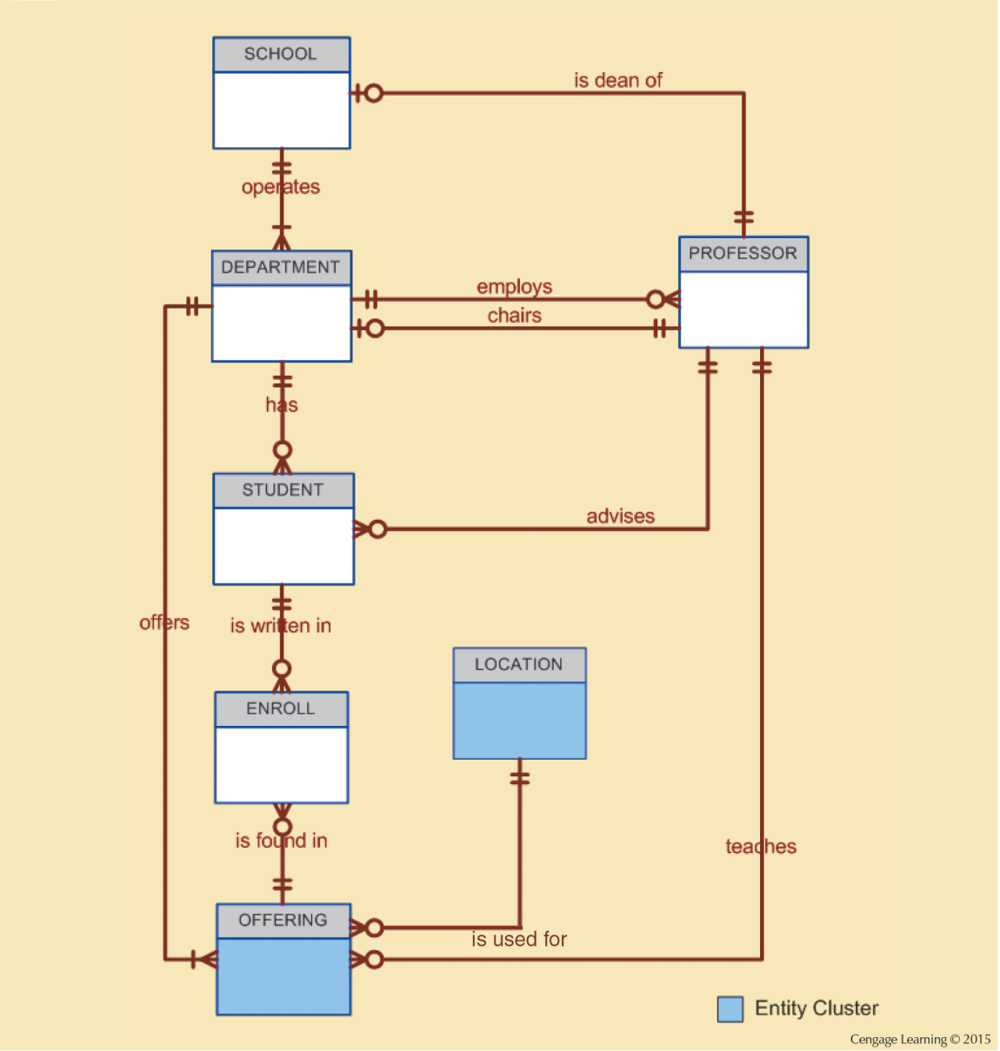
Figure 5.5 - Tiny College ERD Using Entity Clusters

Slide 18
Primary Keys
Single attribute or a combination of attributes, which uniquely identifies each entity instance
  Guarantees entity integrity
  Works with foreign keys to implement relationships

Slide 19
Natural Keys or Natural Identifier
Real-world identifier used to uniquely identify real-world objects
  Familiar to end users and forms part of their day-to-day business vocabulary
  Also known as natural identifier
  Used as the primary key of the entity being modeled

Slide 20
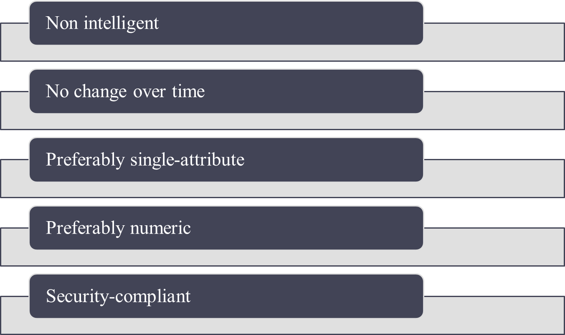
Desirable Primary Key Characteristics

Slide 21
Use of Composite Primary Keys
Identifiers of composite entities
  Each primary key combination is allowed once in M:N relationship
Identifiers of weak entities
  Weak entity has a strong identifying relationship with the parent entity

Slide 22
Use of Composite Primary Keys
When used as identifiers of weak entities, represent a real-world object that is:
  Existence-dependent on another real-world object
  Represented in the data model as two separate entities in a strong identifying relationship

Slide 23
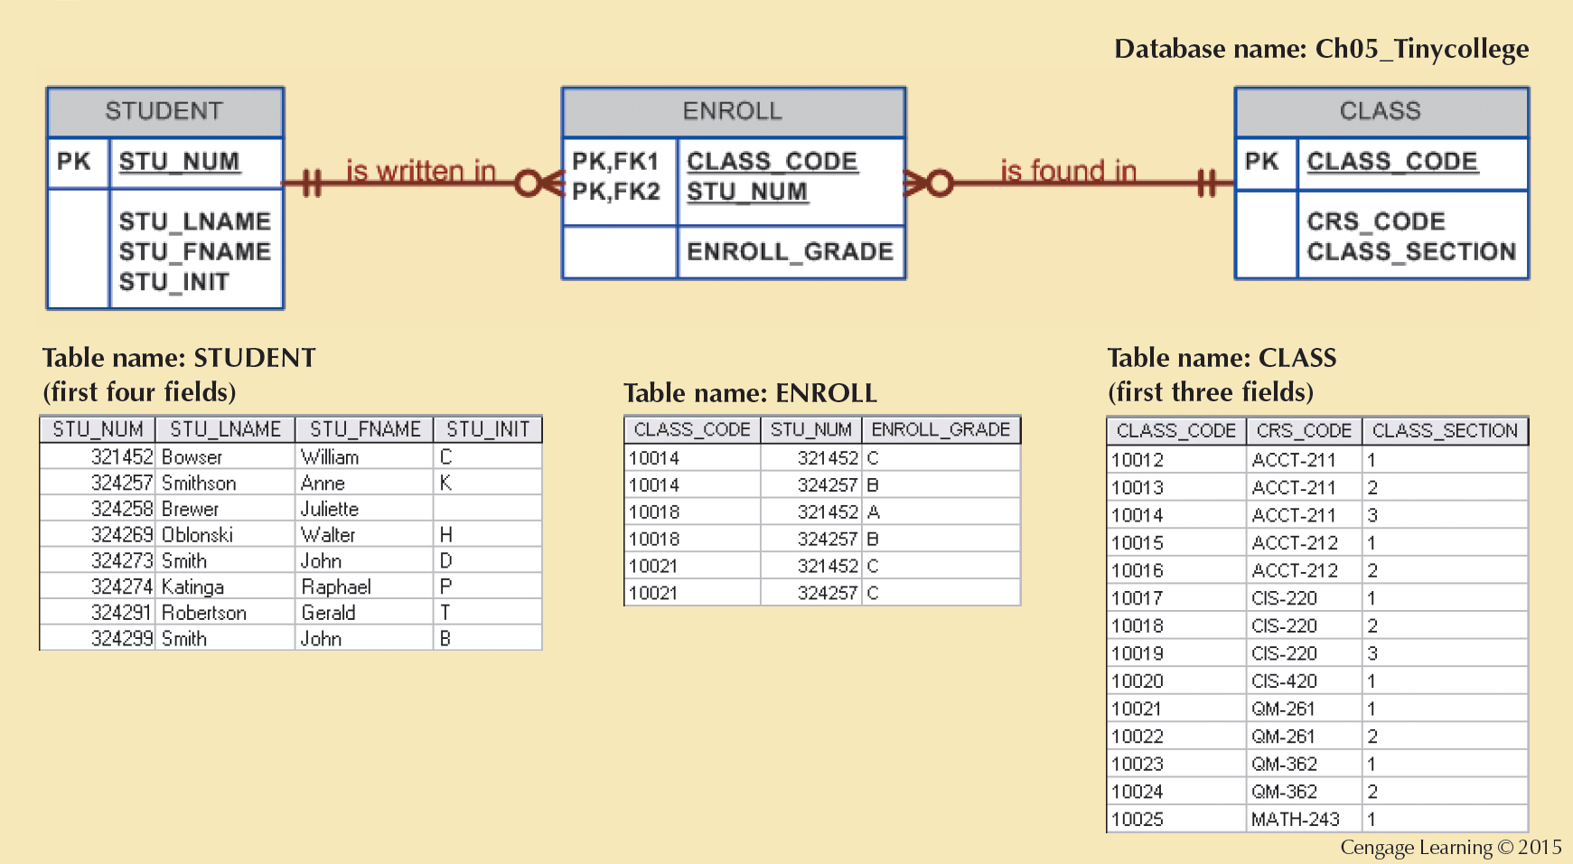
Figure 5.6 - The M:N Relationship between STUDENT and CLASS

Slide 24
Surrogate Keys
Primary key used to simplify the identification of entity instances are useful when:
  There is no natural key
  Selected candidate key has embedded semantic contents or is too long
Require ensuring that the candidate key of entity in question performs properly
  Use unique index and not null constraints

Slide 25
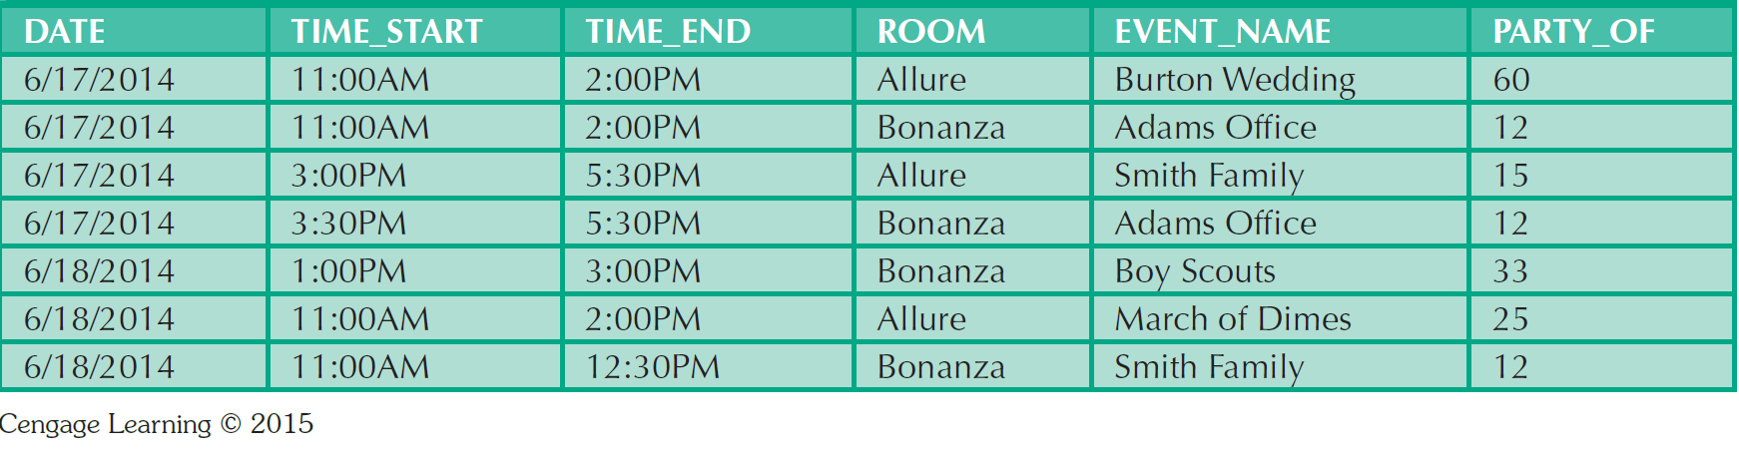
Table 5.4 - Data Used to Keep Track of Events

Slide 26
Design Case 1: Implementing 1:1 Relationships
Foreign keys work with primary keys to properly implement relationships in relational model
Rule
  Put primary key of the parent entity on the dependent entity as foreign key
Options for selecting and placing the foreign key:
  Place a foreign key in both entities
  Place a foreign key in one of the entities

Slide 27
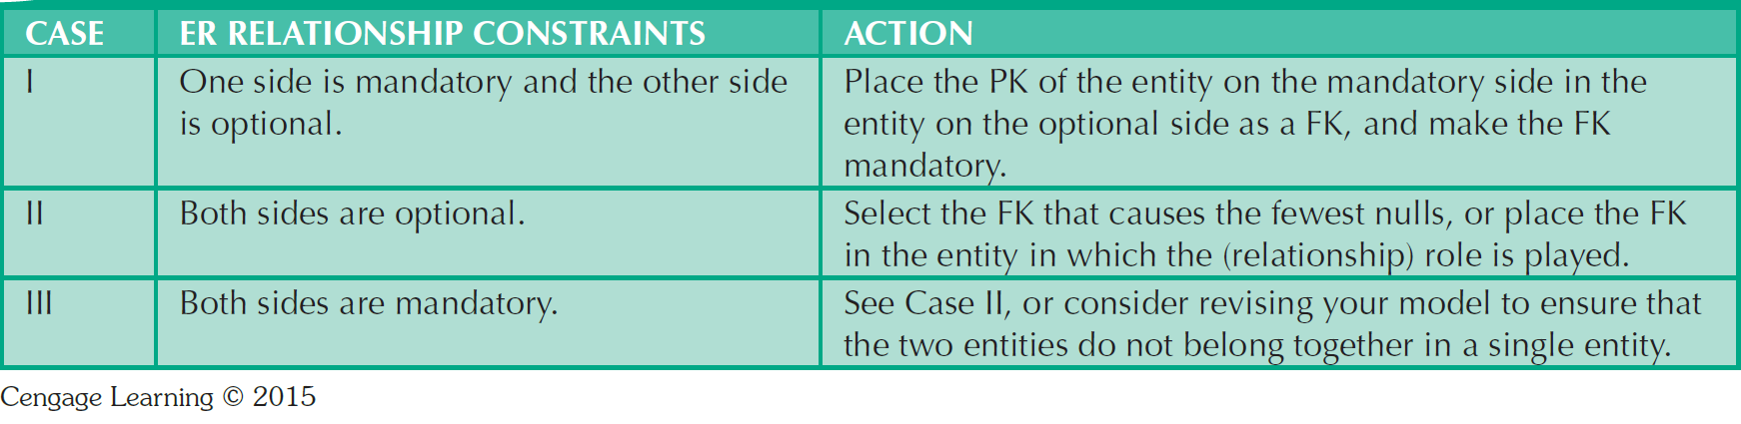
Table 5.5 - Selection of Foreign Key in a 1:1 Relationship

Slide 28
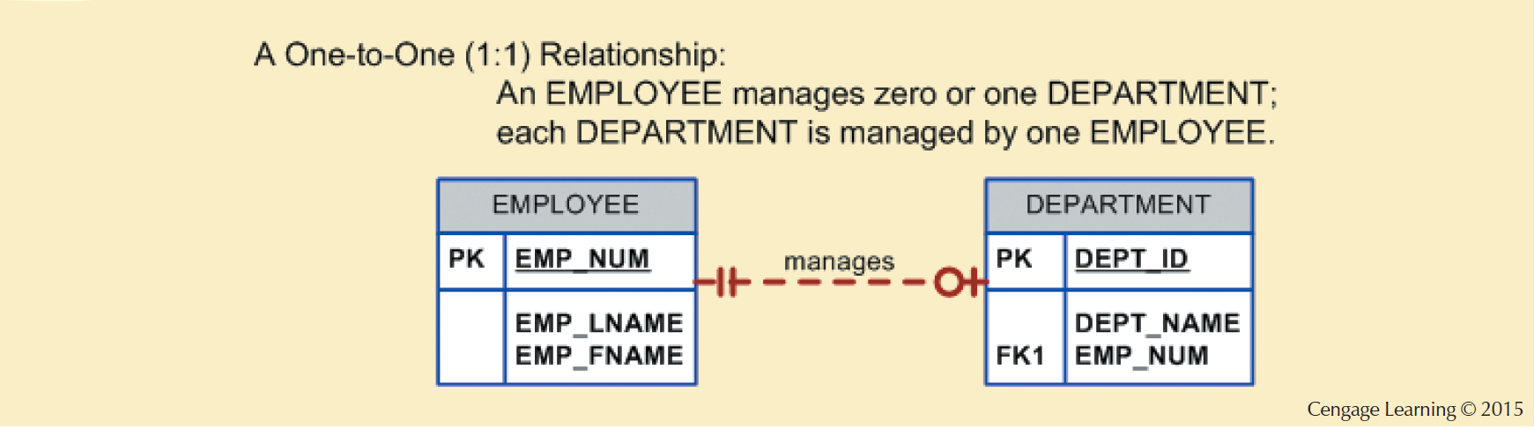
Figure 5.7 - The 1:1 Relationship between Department and Employee

Slide 29
Design Case 2: Maintaining History of Time-Variant Data
Time-variant data: Data whose values change over time and for which a history of the data changes must be retained
  Requires creating a new entity in a 1:M relationship with the original entity
  New entity contains the new value, date of the change, and other pertinent attribute

Slide 30
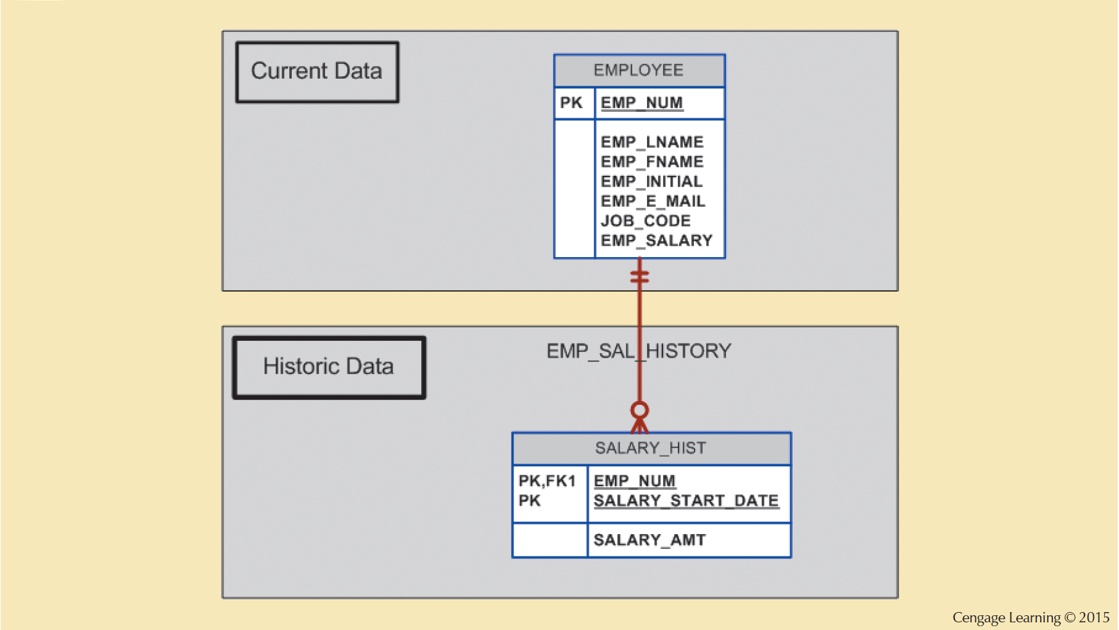
Figure 5.8 - Maintaining Salary History

Slide 31
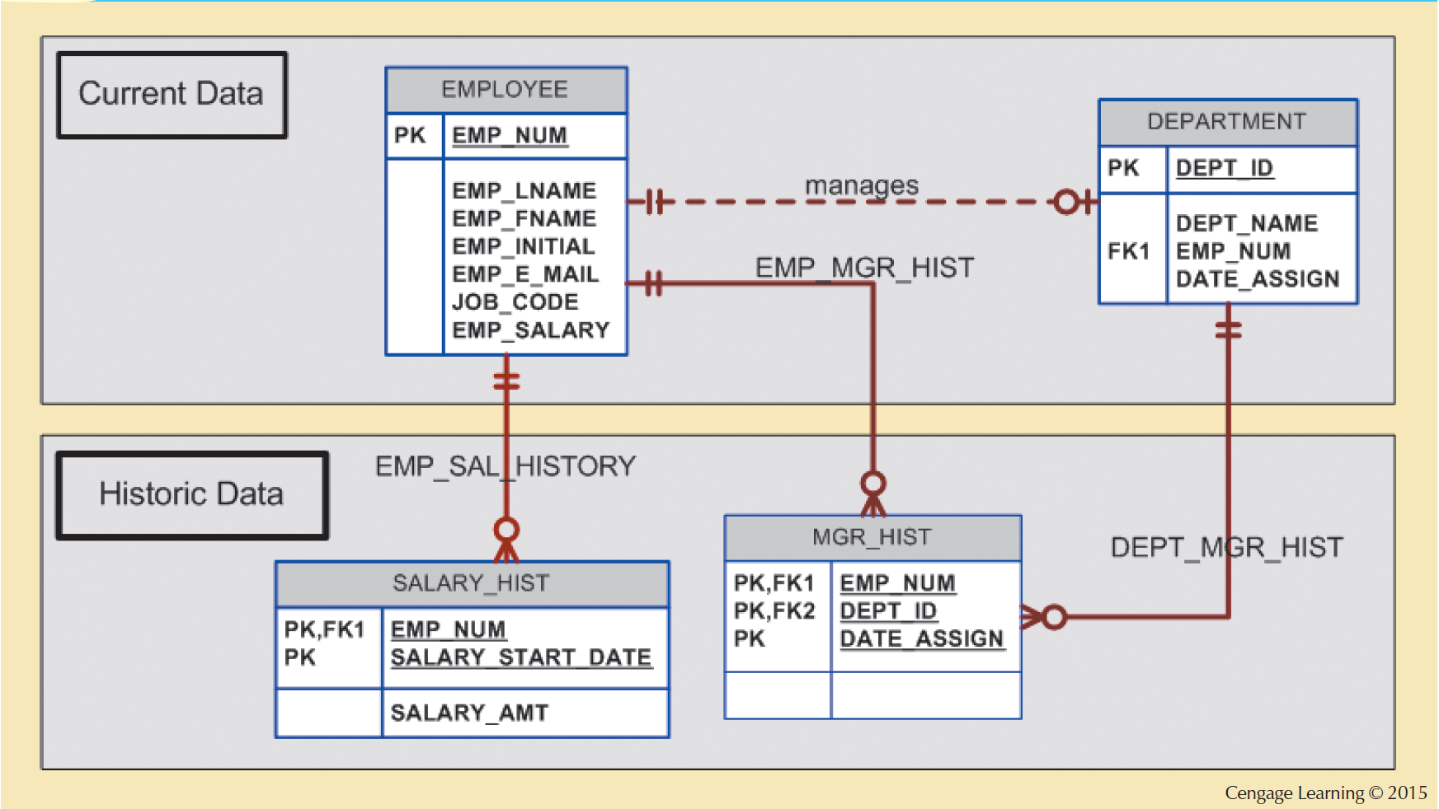
Figure 5.9 - Maintaining Manager History

Slide 32
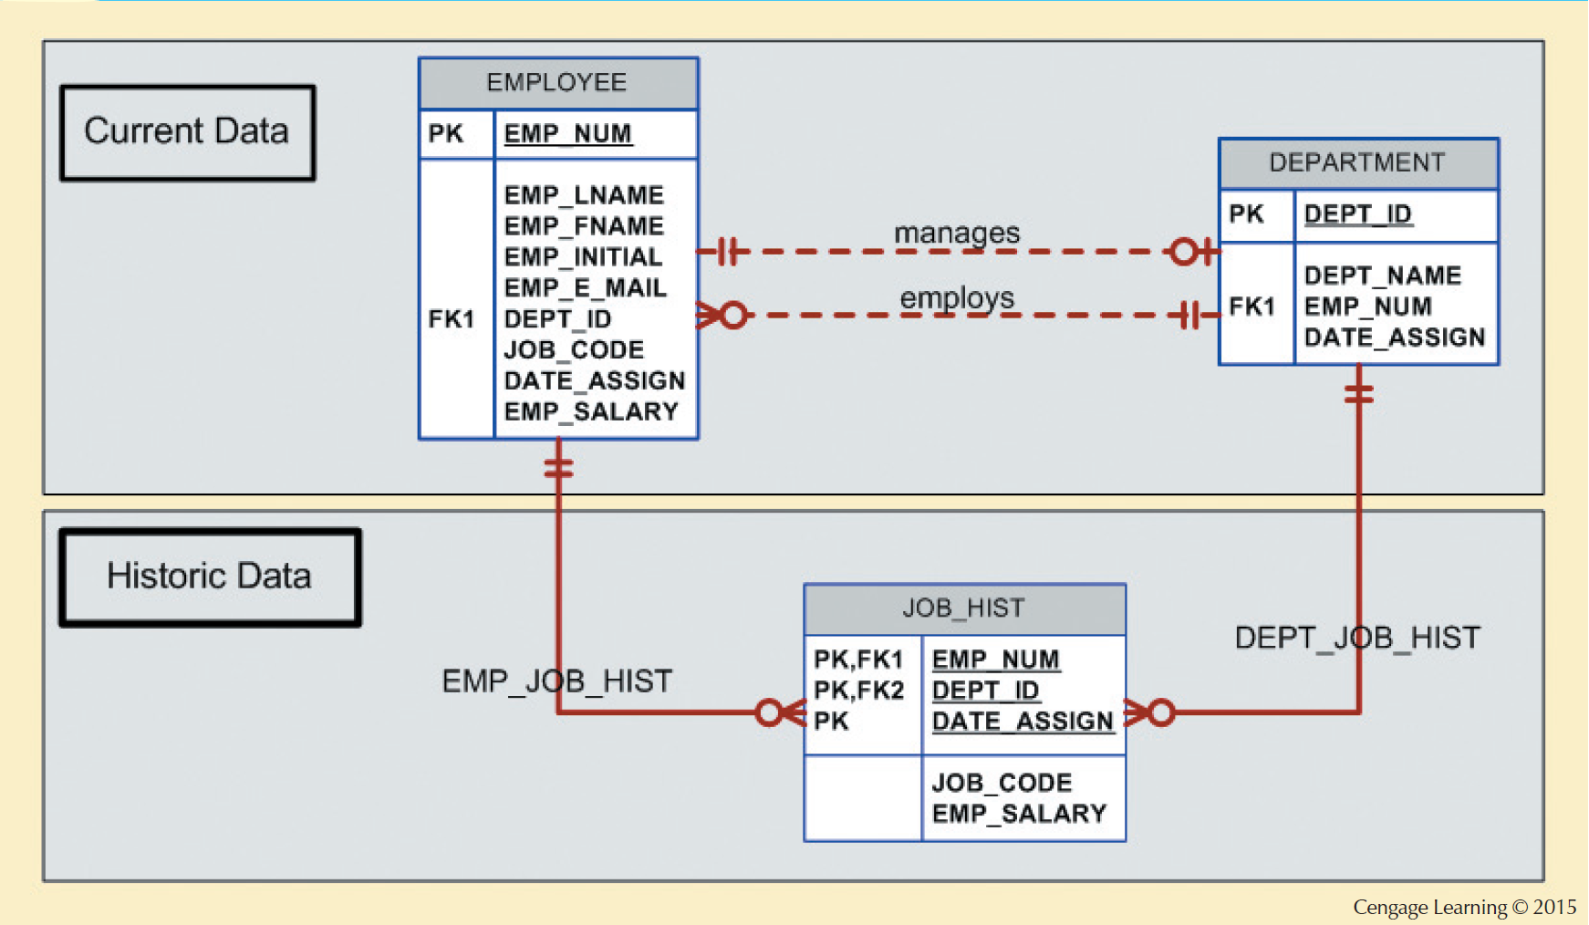
Figure 5.10 - Maintaining Job History

Slide 33
Design Case 3: Fan Traps
Design trap: Occurs when a relationship is improperly or incompletely identified
  Represented in a way not consistent with the real world
Fan trap: Occurs when one entity is in two 1:M relationships to other entities
  Produces an association among other entities not expressed in the model

Slide 34
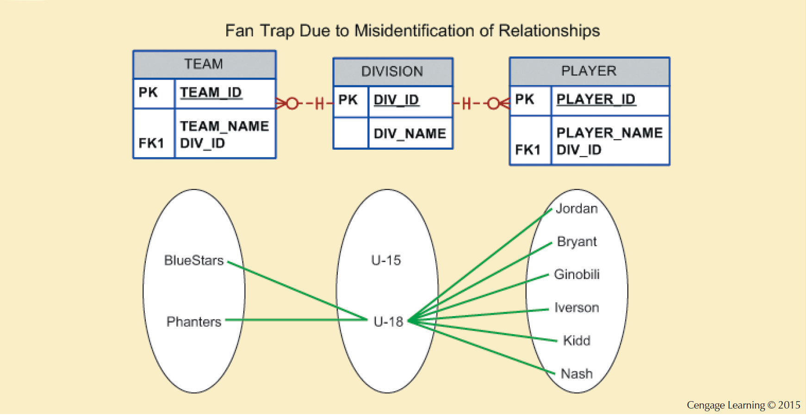
Figure 5.11 - Incorrect ERD with Fan Trap Problem

Slide 35
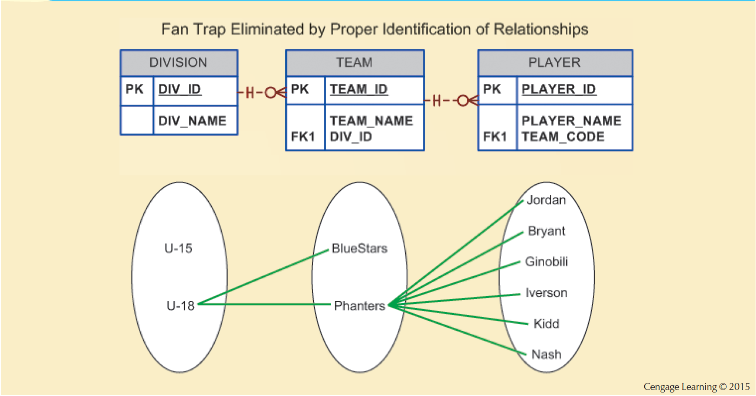
Figure 5.12 - Corrected ERD After Removal of the Fan Trap

Slide 36
Design Case 4:
Redundant Relationships
Occur when there are multiple relationship paths between related entities
Need to remain consistent across the model
Help simplify the design

Slide 37
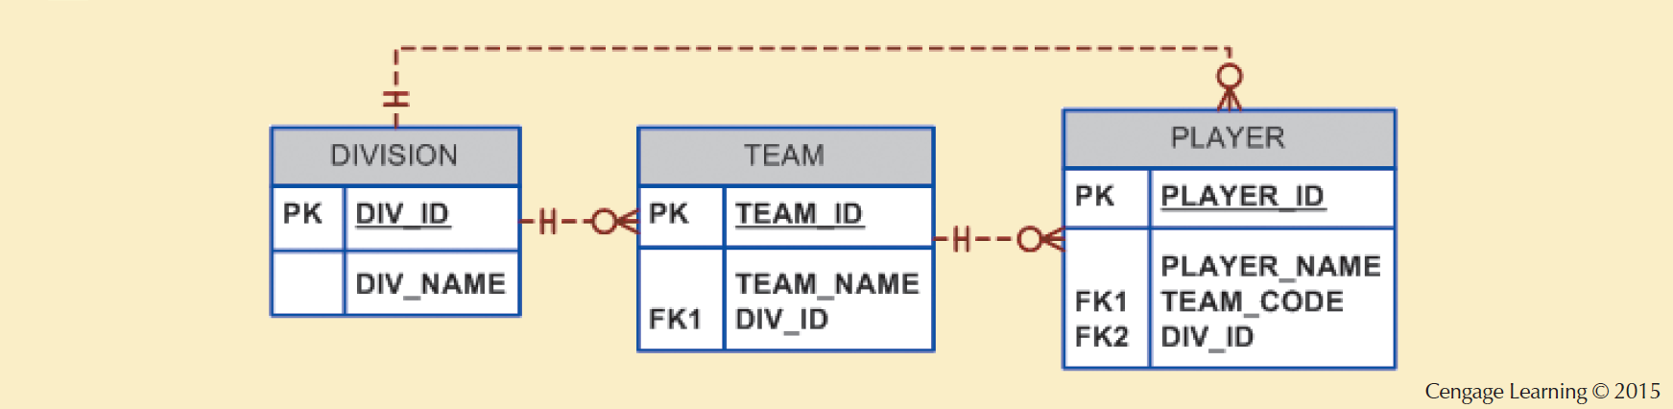
Figure 5.13 - A Redundant Relationship

